Slide 1
Decoding Spotify Hits: Audio Features & Artist Trends
Parva Shah (ps7384)
Jahnavi Kaja (jk4266)

Slide 2
Intro
Dataset Source & Scope
Kaggle historical tracks + Spotify Top-50 snapshots
113,549 unique tracks spanning 1971–2024
Key Attributes
Metadata: track ID, name, artists, album, genre, release date
Audio features: danceability, energy, loudness, speechiness, acousticness, instrumentalness, liveness, valence, tempo
Popularity metrics: normalized “popularity” score & High/Medium/Low tiers

Slide 3
Data Preparation & Feature Engineering
Source Files
Track Metadata (spotify_tracks.csv): • id, name, artists, album, genre, popularity, duration_ms, explicit
High-Popularity Features (high_popularity_spotify_data.csv): • danceability, energy, loudness, acousticness, instrumentalness, liveness, valence, tempo for top-tier tracks
Low-Popularity Features (low_popularity_spotify_data.csv): • speechiness, time_signature, low-pop popularity_low
Feature Engineering
Categoricals: • explicit_cat (Clean vs. Explicit) • time_signature_cat (e.g. “4/4”)
Temporal: extracted release_year & decade from album release date
Normalization: Min–Max scaled all numeric audio/popularity fields to [0,1]

Slide 4
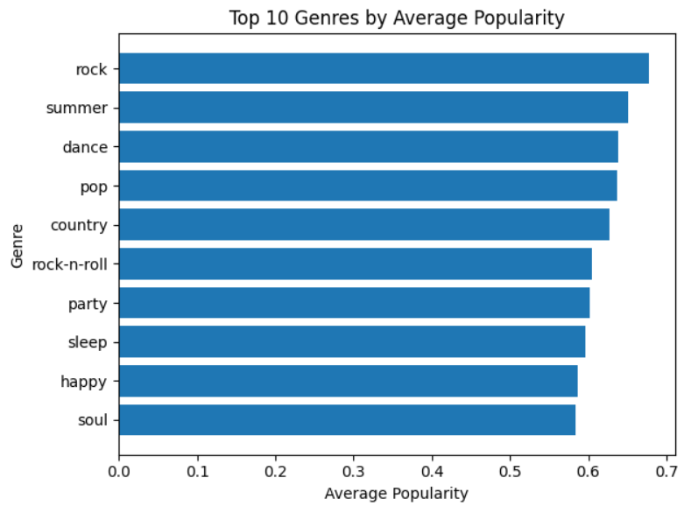
Top 10 Genres by Average Popularity
Rock leads, followed by Summer, Dance, and Pop
“Chill” or niche genres like Sleep & Happy also rank in top 10

Slide 5
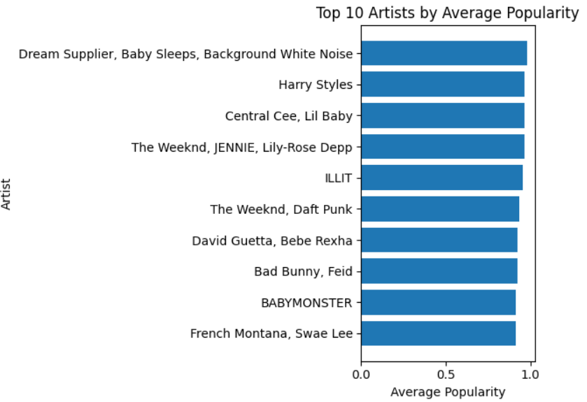
Top 10 Artists by Average Popularity
Leaders: Dream Supplier & Baby Sleeps (white-noise niche), The Weeknd collaborations, Harry Styles
Insight: Pop-culture icons and viral “playlist brands” co-exist at the top.

Slide 6
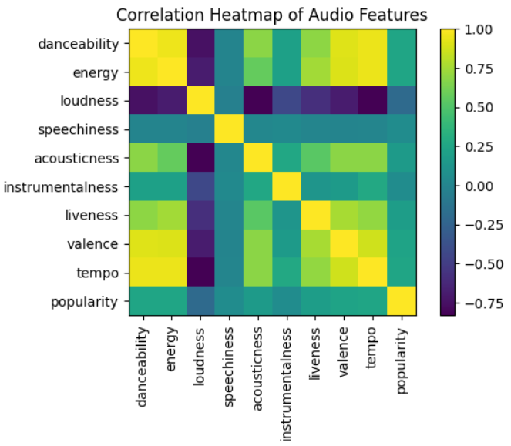
Audio-Feature Correlation Heatmap
Strong Positives:
Danceability ⇄ Energy (~ +0.9)
Valence ⇄ Tempo (~ +0.8)
Strong Negatives:
Loudness ⇄ Acousticness (~ −0.8)
Use: Guides feature-selection for modeling or playlist curation.

Slide 7
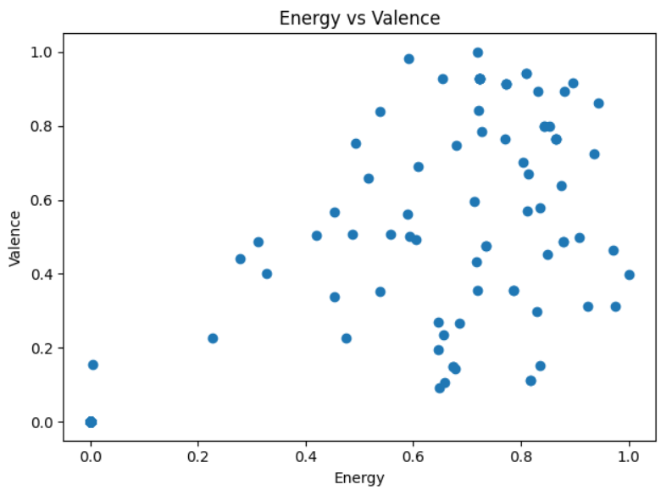
Energy vs. Valence
Quadrants:
High energy & high valence = “upbeat hits”
Low energy & low valence = “moody tracks”
Observation: Popular songs lean toward the high-energy/high-valence quadrant.

Slide 8
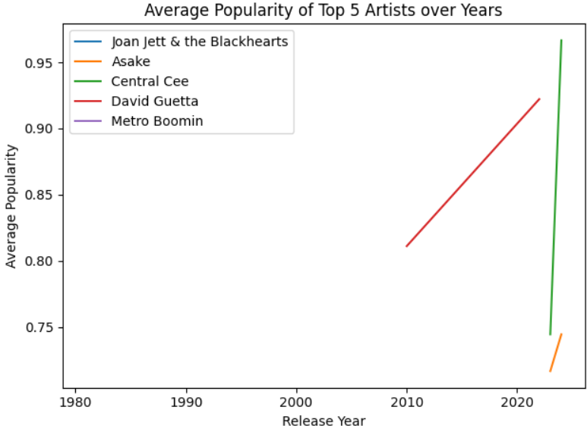
Top 5 Artists’ Popularity Trends
Central Cee: Rapid climb 2022→2024
Asake & David Guetta: Mid-career peaks

Slide 9
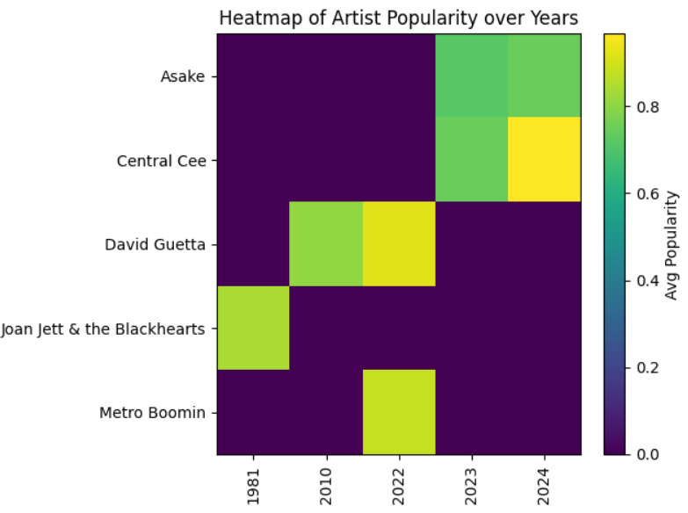
Top 5 Artists’ Popularity Heatmap
Visual map of when each artist had their “golden years”
Empty periods highlight gaps or sporadic releases.

Slide 10
Conclusion
Unified Dataset: Combined 3 sources into 113K+ tracks with metadata, audio features, release dates, and popularity tiers.
Hit Drivers: Danceability ⇄ Energy and High Energy + High Valence strongly correlate with popularity.
Genre & Artist Trends: Rock and feel-good (“Sleep,” “Happy”) genres lead artist trajectories range from long-term steady hits to rapid recent climbs.
Temporal Insights: Post-2020 release volume surged. 2020s show the widest popularity spread, indicating both blockbusters and niches.
Next Steps: Build an interactive dashboard.

